Slide 2


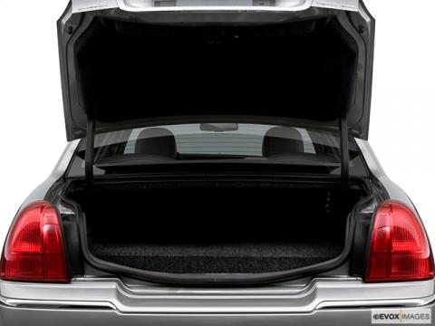

Initial Problem Statement

Slide 3
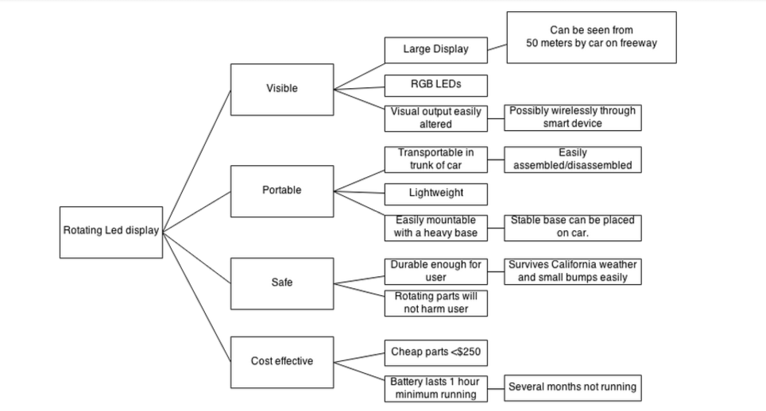
Objective Tree

Slide 4
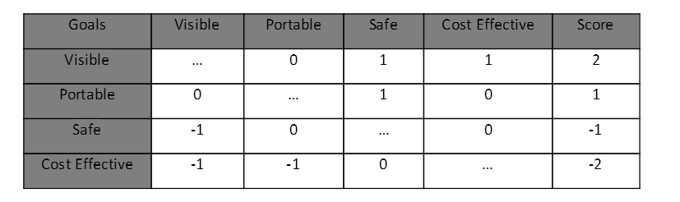
Pairwise Comparison Chart
Visibility was most important and Cost was the least important.

Slide 5
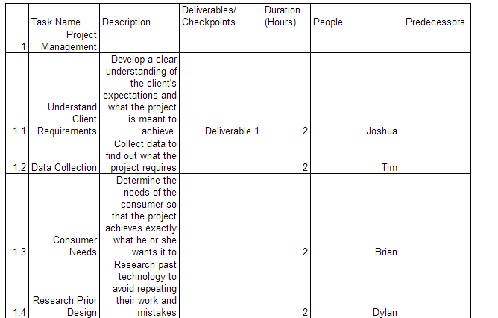
Work Breakdown Structure

